Slide 1
Express Yourself
Lesson 11.2

Slide 2
A new face in the classroom
My name’s Catherine Pham, and I am a former wildlife biologist. I graduated from the UW boot camp in June 2019, and since then, I’ve TA-ed, tutored, and gotten a full-time job with iSoftStone, a global tech consulting company over in Kirkland.
Feel free to connect with me on Slack and LinkedIn!
https://www.linkedin.com/in/catherinephamcww/
In modern web applications there is a constant back-and-forth communication between the visuals displayed on the user’s browser (frontend) and the data and logic stored on the server (backend).
Intro to Node Servers

Slide 3
Early Concerns

Slide 4


Comment #1
This is all so confusing.
Notes:
shutterstock_1188695488

Slide 5

Comment #1: “This is all so confusing.”
Response: And it will be for your employer as well.
Notes:
shutterstock_112957384

Slide 6
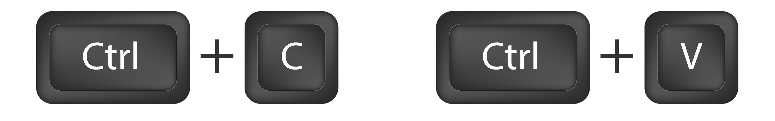
Comment #1
I feel like I’m just copying and pasting.
Notes:
Image source: shutterstock_318828878

Slide 7

Comment #1: “I feel like I’m just copying and pasting.”
Response:
We’re gaining more and more tools to keep DRY
Oftentimes things start as copy/paste and are then DRYed up
Notes:
Image source: shutterstock_318828878

Slide 8

Comment #2
I feel like I’m just Googling.
Notes:
Image source: shutterstock_318828878

Slide 9
Comment #2: “I feel like I’m just Googling.”
Response:
That’s what we do.
Notes:
Image source: shutterstock_318828878

Slide 10
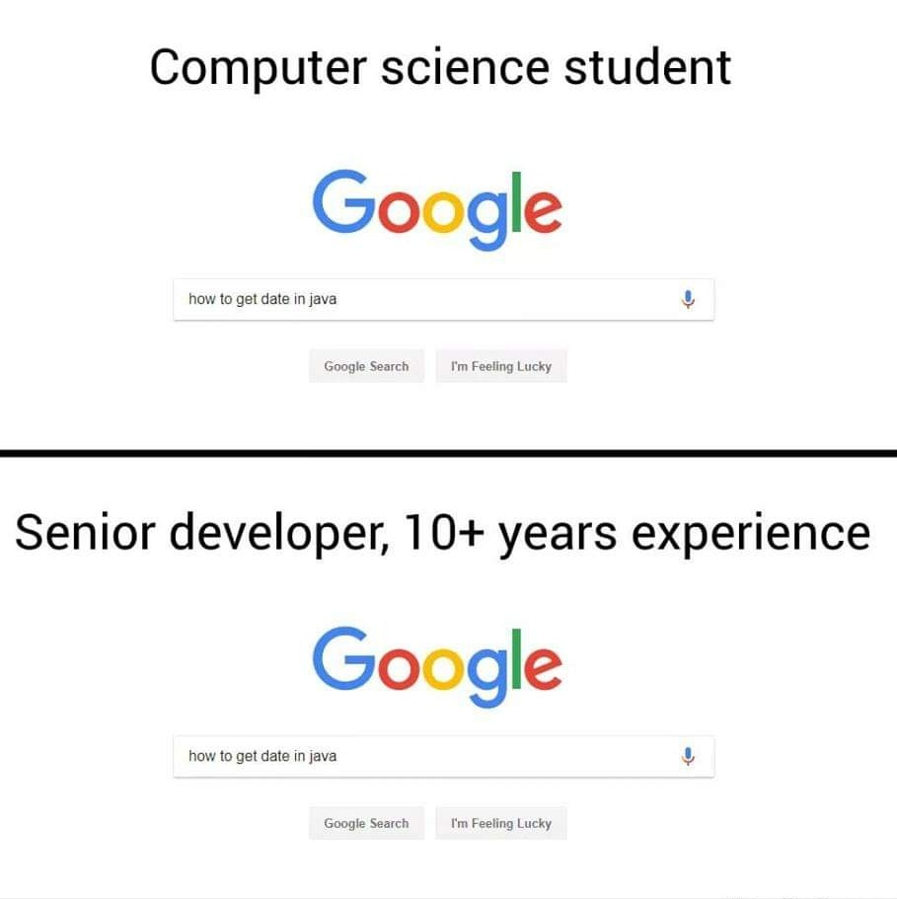

Slide 11
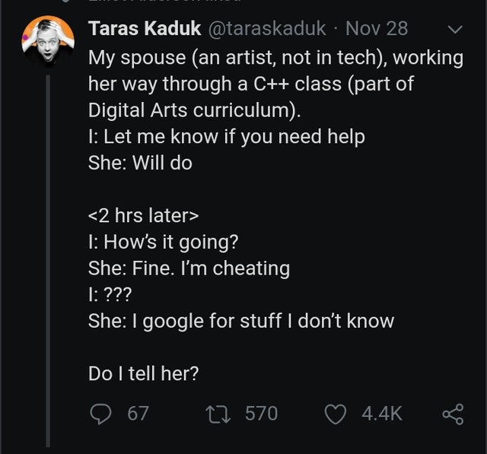
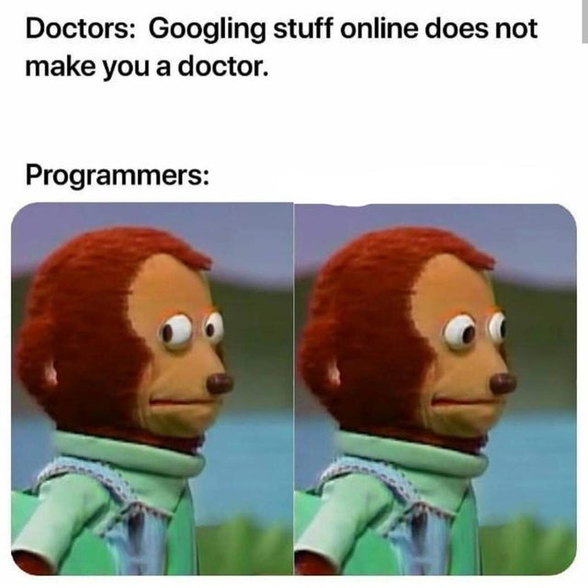
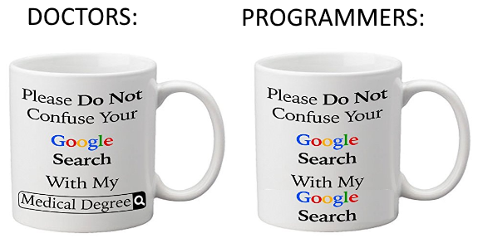

Slide 12
Today’s Class

Slide 13
Your Objectives Today
Before you walk out the door, you should:
Know how to create a generic Express server
Know how to create a basic Express GET route
Know how to create an Express POST route
Be capable of using POSTMAN
Understand “conceptually” how to use AJAX to GET and POST data to an Express server

Slide 14
A Moment to Refresh

Slide 15
Activity: A Big Box
Take a few moments to answer the following questions with the person next to you:
01
How does this box represent a server?
02
What modules or “sub-boxes” commonly exist inside?
Server

Slide 16

Inside the Box, and More!
In a way, servers can be represented as hardware boxes with modules of server-side code contained inside.
Server
Listen | URL Parse
Route Handling
Send HTML | Send JSON
Receive POSTs | Server-Side Logic
And More!
Servers typically contain code for tasks such as listening, parsing URLs, route handling, and more.

Slide 17
Express

Slide 18
Remind Me Again
What is Express?
In modern web applications there is a constant back-and-forth communication between the visuals displayed on the user’s browser (frontend) and the data and logic stored on the server (backend).
Notes:
Image source: shutterstock_1051979417

Slide 19
Express.JS
Express is a web framework for Node that makes creating server-side code much simpler.

Slide 20
Remind Me Again
What is a route?
In modern web applications there is a constant back-and-forth communication between the visuals displayed on the user’s browser (frontend) and the data and logic stored on the server (backend).
Notes:
Image source: shutterstock_1051979417

Slide 21

Routes = Maps
Notes:
shutterstock_461093119

Slide 22
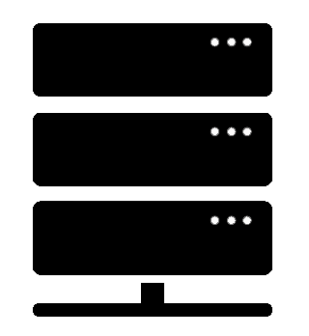

Routes = Maps
User visits a link…
/
Server
User is shown the “Home” Page
/saved
User is shown the “Saved” Page
/api/headlines
User is given JSON containing all of the headline data.
Notes:
Trilogy created diagram does not violate copyright

Slide 23
Quick Example
nyt-mongo-scraper.herokuapp.com

Slide 24
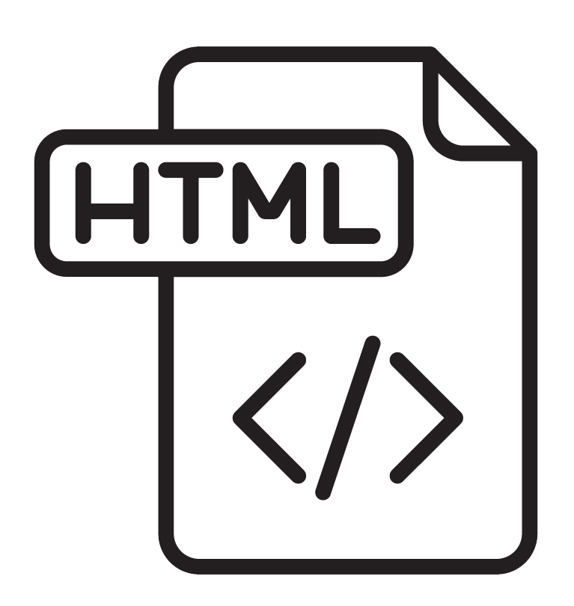

Client-Server Communication (GET)
1
User visits “/” route
GET Request
Client Browser Home Page
Node Server
Notes:
Trilogy created diagram does not violate copyright

Slide 25
Client-Server Communication (GET)
1
User visits "/saved" route
2
GET Request
Request triggers the code in the server route. The server then finds the relevant HTML content and data.
Client Browser Saved Articles
Node Server
3
Server responds by providing HTML with saved articles.
Notes:
Trilogy created diagram does not violate copyright

Slide 26
Client-Server Communication (POST)
1
User saves an article using ”api/headlines”.
POST Request
Client Browser Clicks on Save Article button
Node Server
Notes:
Trilogy created diagram does not violate copyright

Slide 27
Client-Server Communication (POST)
1
User saves an article using ”api/headlines”.
2
POST Request
Request triggers the code in the server route. The server then sets the article as “saved” in the database.
Client Browser Clicks on Save Article button
Node Server
3
“Saved” articles are loaded on the saved page.
Notes:
Trilogy created diagram does not violate copyright

